Slide 1
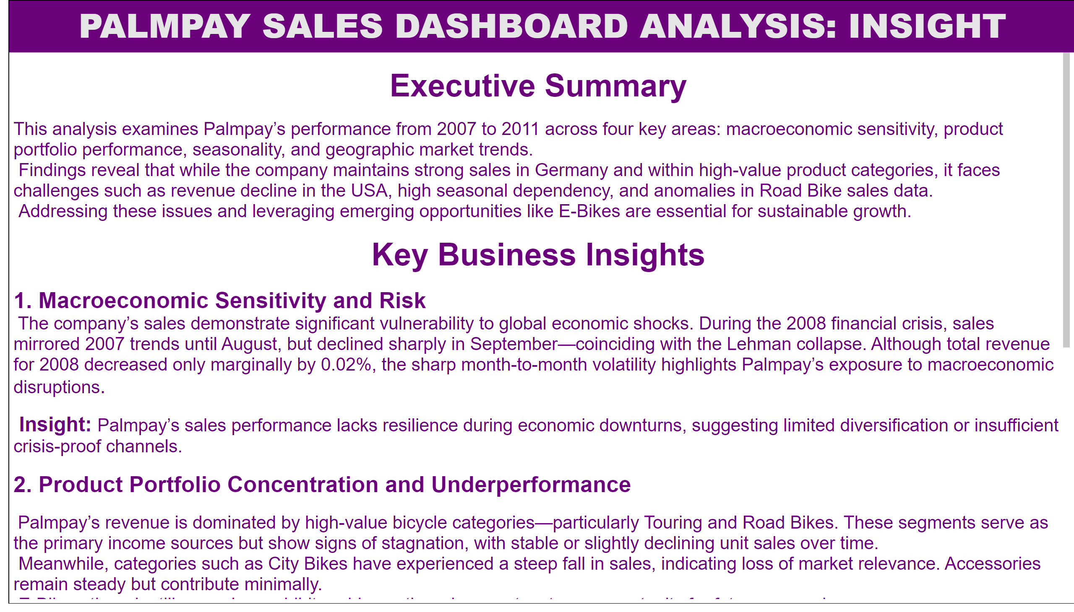
INSIGHT
Notes:
PALMPAY SALES DASHBOARD ANALYSIS: INSIGHT
No alt text provided

Slide 2
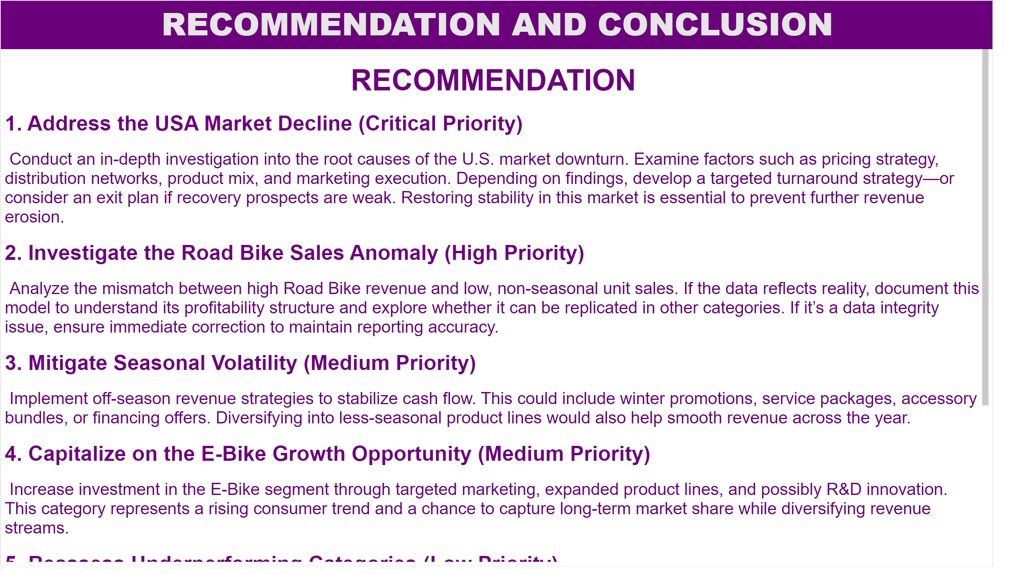
RECOMMENDATION AND CONCLUSION
Notes:
RECOMMENDATION AND CONCLUSION
No alt text provided

Slide 3
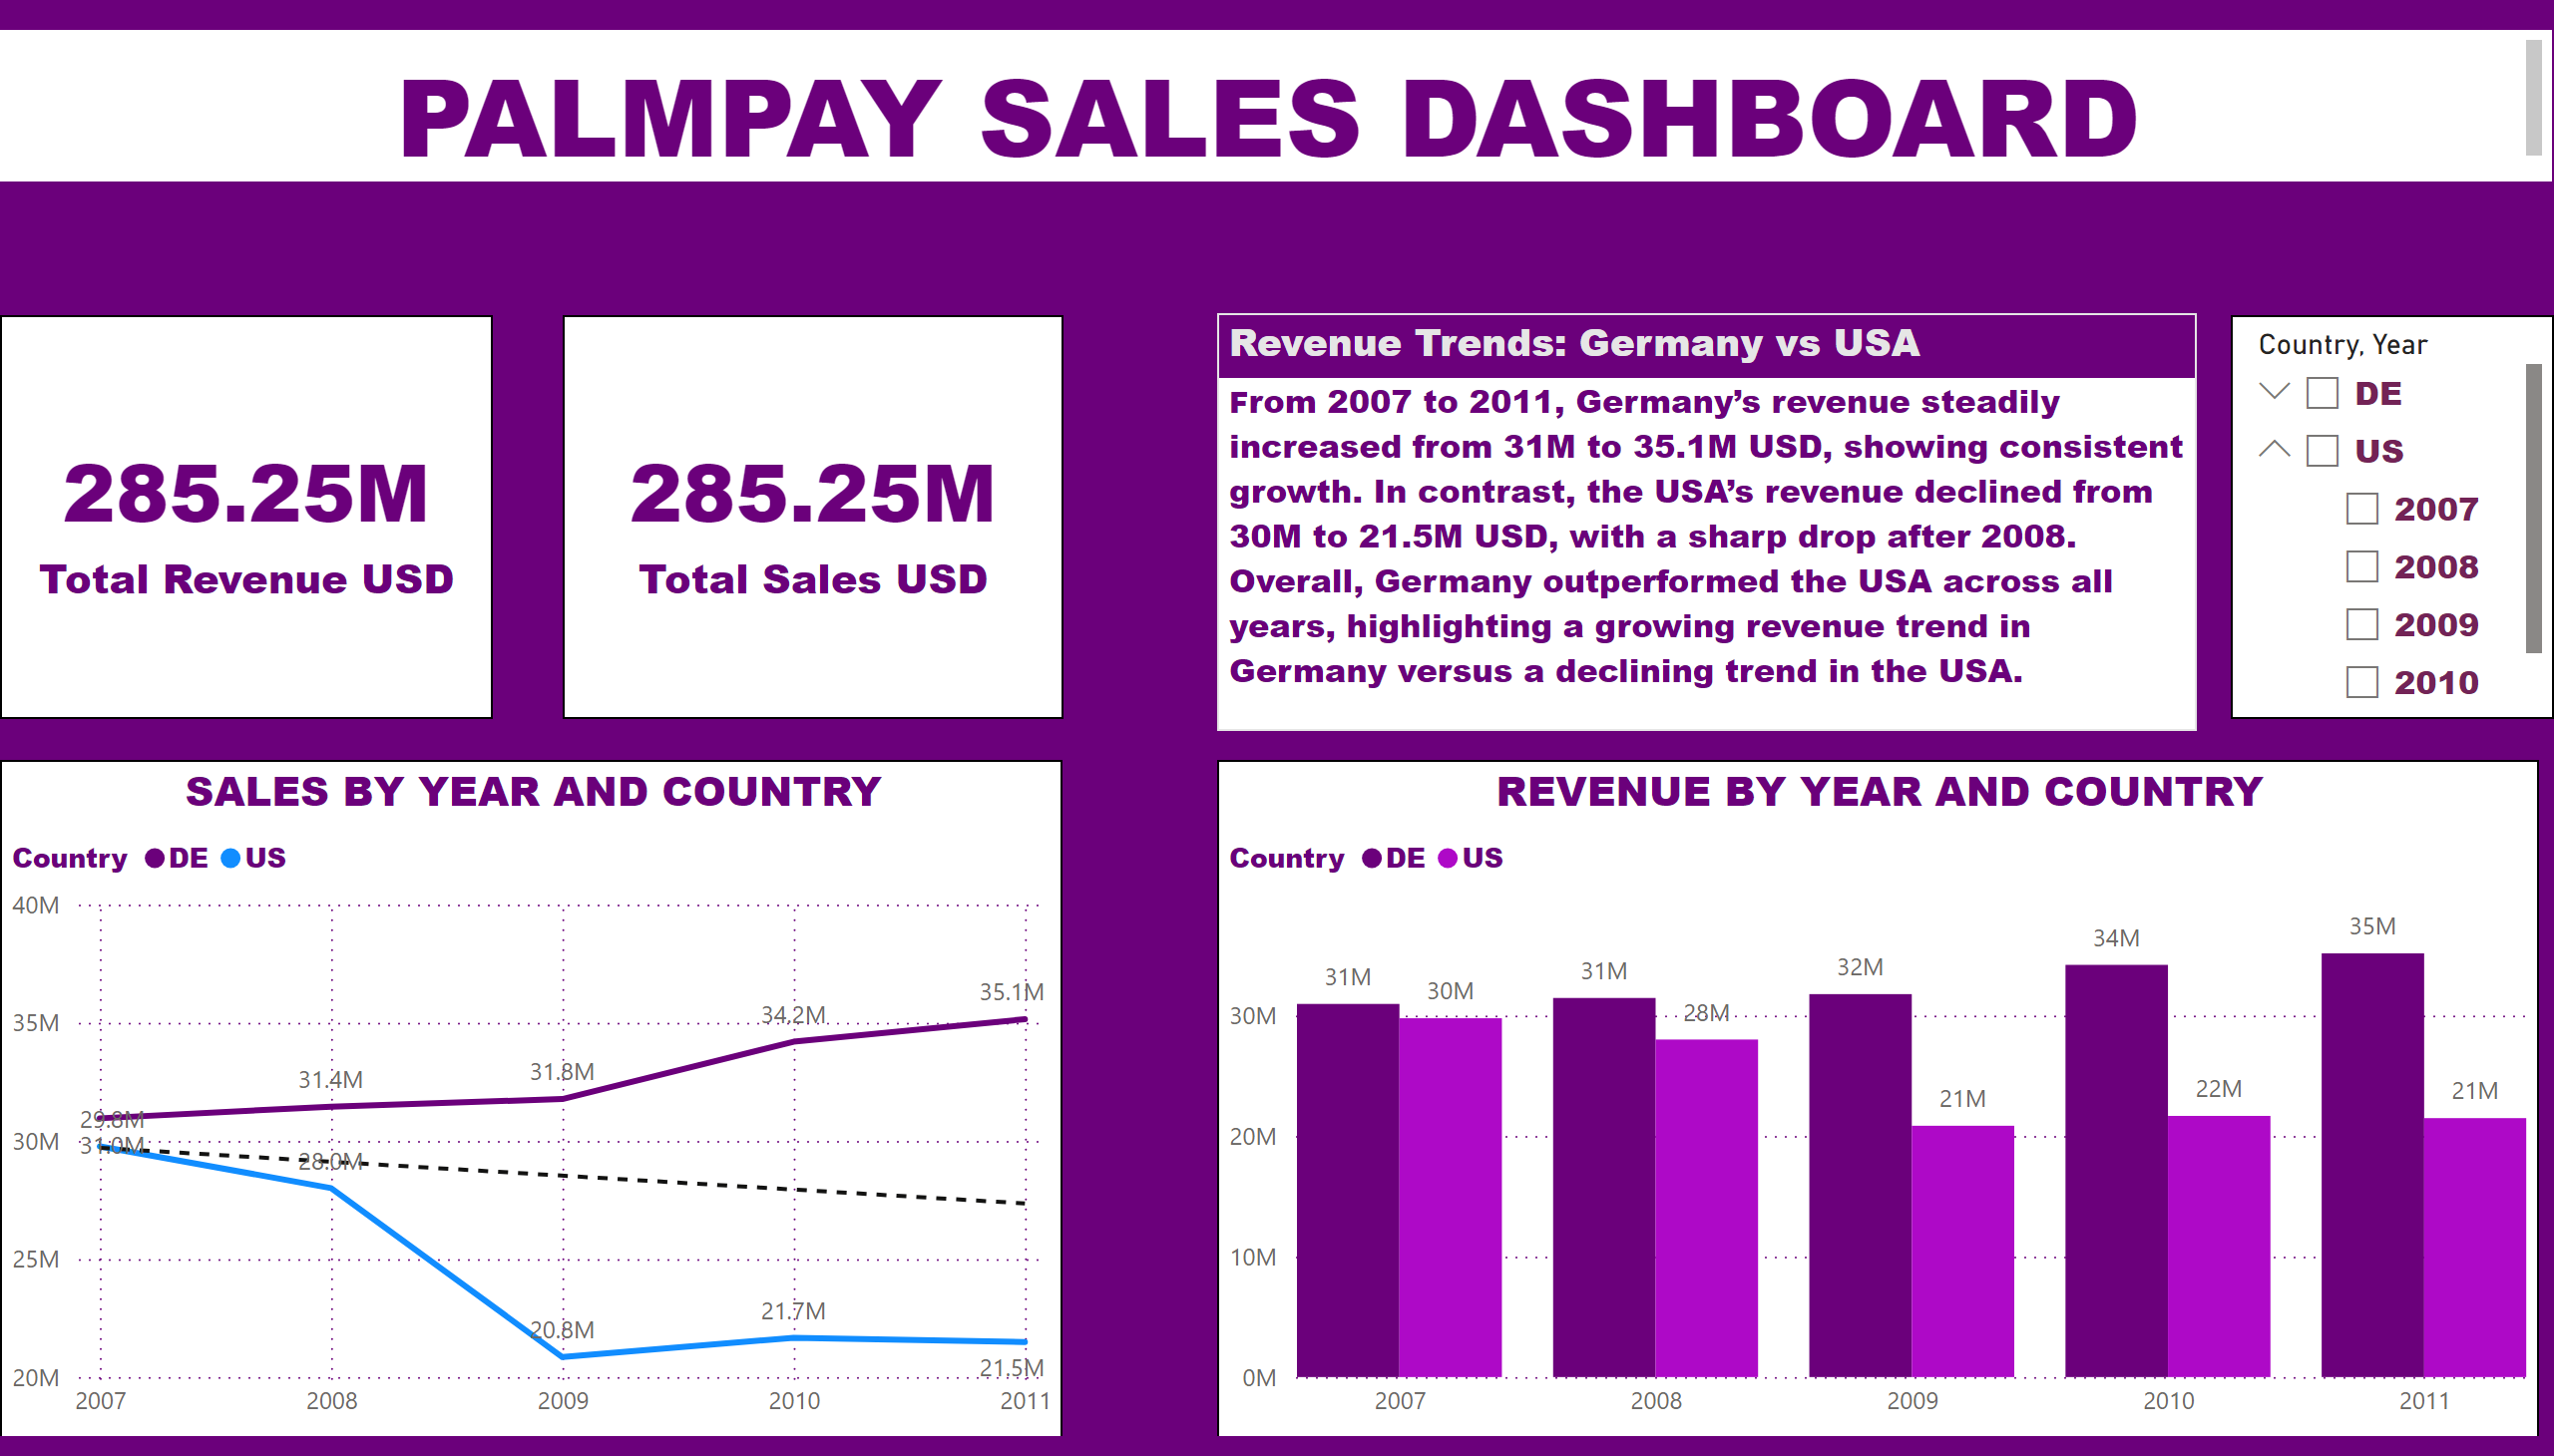
SECTION A1 COUNTRY SALES TREND
Notes:
slicer
No alt text provided
textbox
No alt text provided
card
No alt text provided
card
No alt text provided
REVENUE BY YEAR AND COUNTRY
No alt text provided
SALES BY YEAR AND COUNTRY
No alt text provided
Revenue Trends: Germany vs USA
No alt text provided

Slide 4
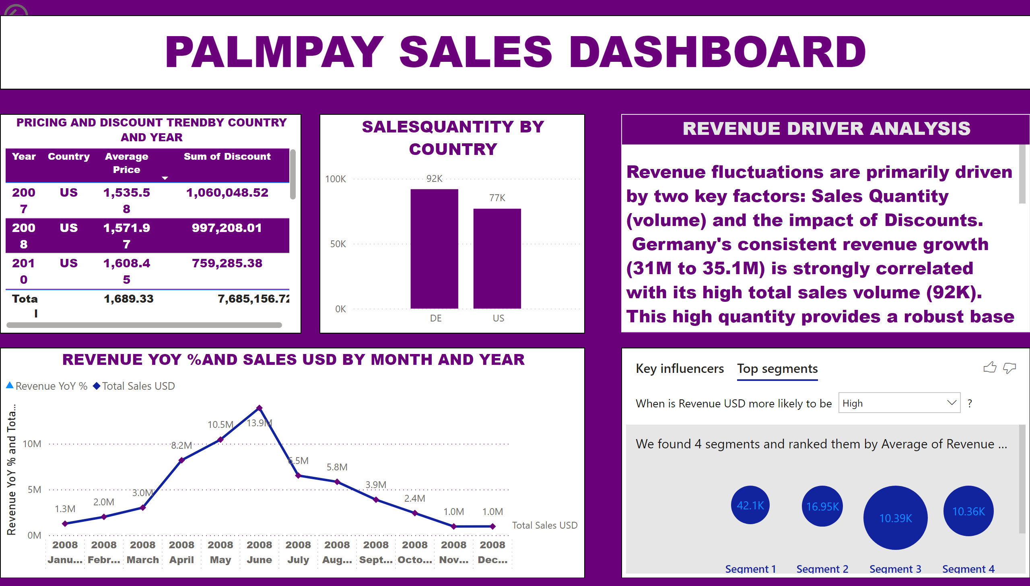
SECTION A2 SALES DRIVERS
Notes:
actionButton
No alt text provided
REVENUE YOY %AND SALES USD BY MONTH AND YEAR
No alt text provided
keyDriversVisual
No alt text provided
PRICING AND DISCOUNT TRENDBY COUNTRY AND YEAR
No alt text provided
SALESQUANTITY BY COUNTRY
No alt text provided
textbox
No alt text provided
REVENUE DRIVER ANALYSIS
No alt text provided

Slide 5
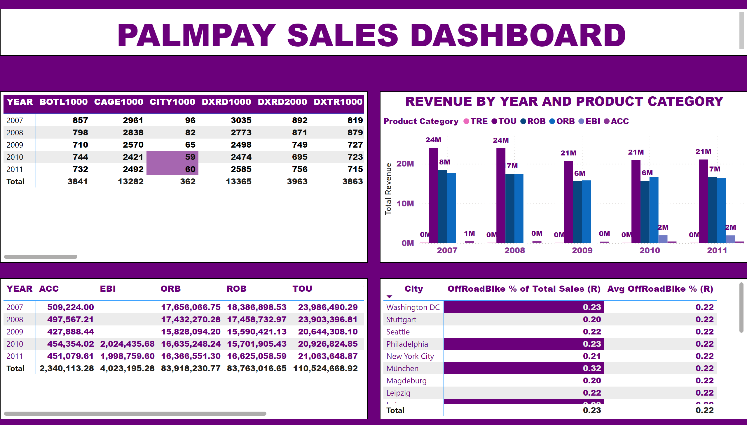
SECTION B SALES BY PRODUCT CATEGORY
Notes:
pivotTable
No alt text provided
REVENUE BY YEAR AND PRODUCT CATEGORY
No alt text provided
pivotTable
No alt text provided
pivotTable
No alt text provided
textbox
No alt text provided

Slide 6
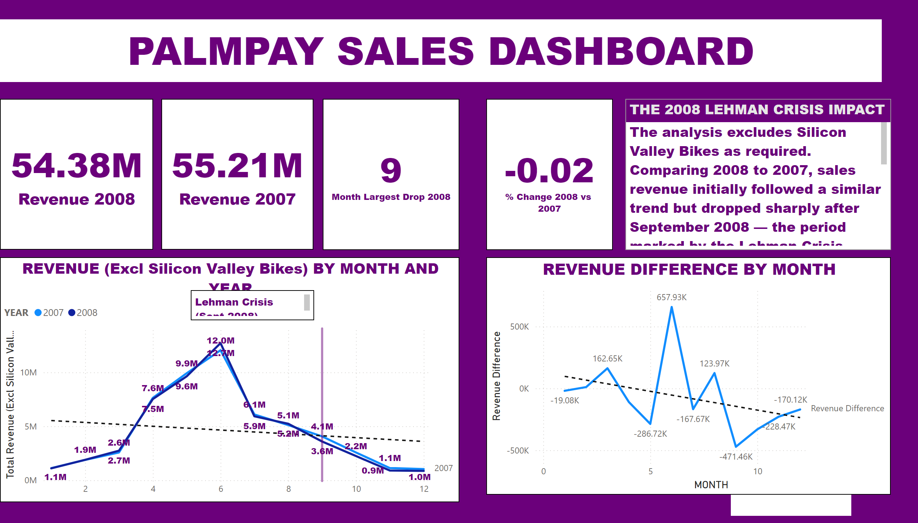
SECTION A3 THE LEHMAN CRISIS IMPACT
Notes:
kpi
No alt text provided
textbox
No alt text provided
REVENUE (Excl Silicon Valley Bikes) BY MONTH AND YEAR
No alt text provided
Lehman Crisis (Sept 2008)
No alt text provided
REVENUE DIFFERENCE BY MONTH
No alt text provided
card
No alt text provided
card
No alt text provided
card
No alt text provided
card
No alt text provided
THE 2008 LEHMAN CRISIS IMPACT
No alt text provided
textbox
No alt text provided

Slide 7
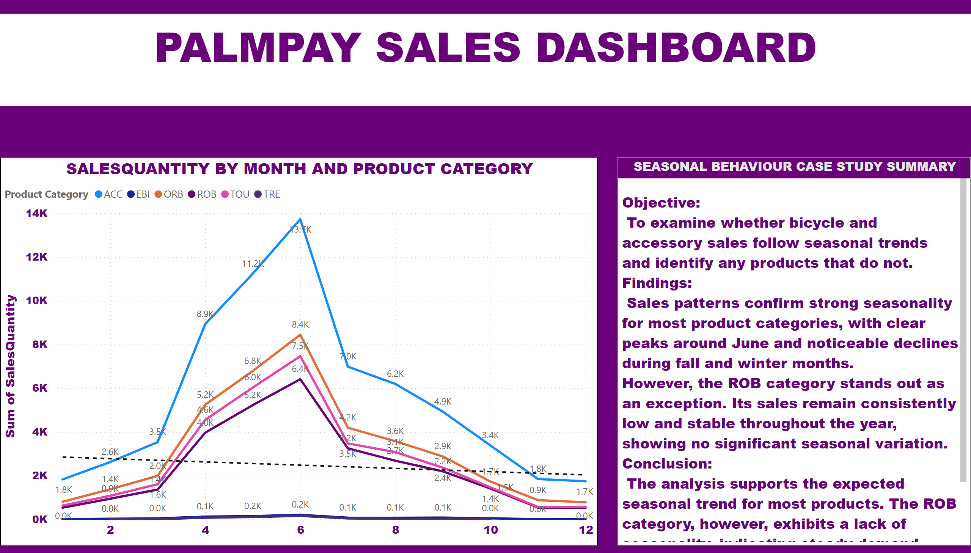
SECTION B SEASONAL BEHAVIOUR CASE STUDY SUMMARY
Notes:
SALESQUANTITY BY MONTH AND PRODUCT CATEGORY
No alt text provided
textbox
No alt text provided
SEASONAL BEHAVIOUR CASE STUDY SUMMARY
No alt text provided

Slide 8

ATTENDANCE
Notes:
textbox
No alt text provided

